Slide 1
Biochemistry: Lecture 2
Shivam Singh and Dhanush Banka

Slide 2
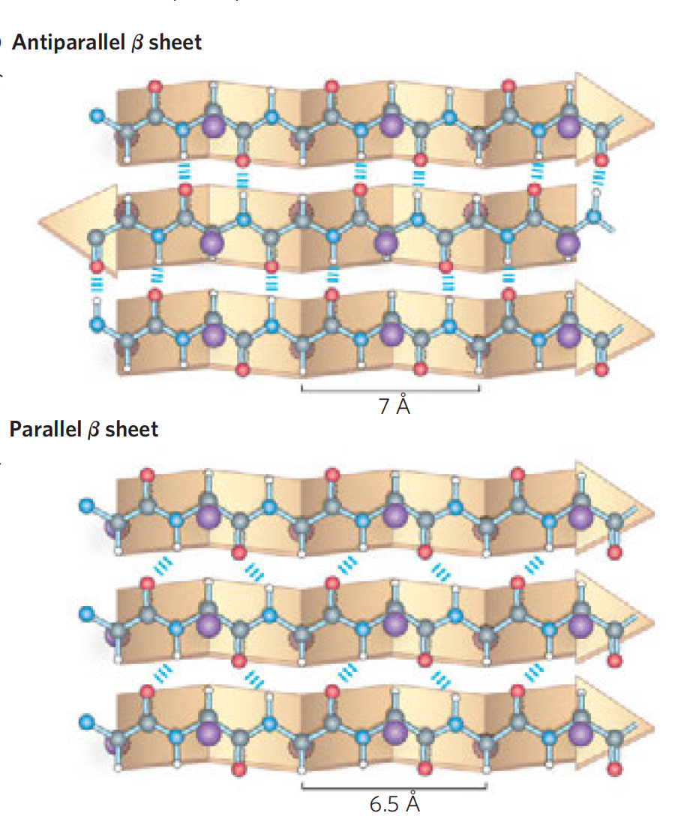
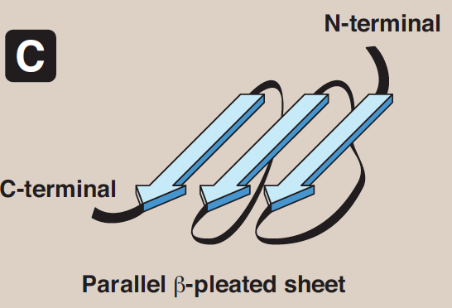
Secondary Structure: 𝛽 (“pleated”) sheet
peptide bond components involved in hydrogen bonding
composed of two or more peptide chains
parallel OR/AND antiparallel

Slide 3
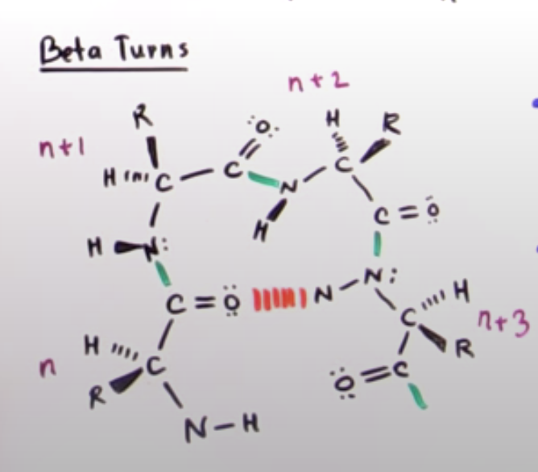
𝛽-turns (𝛽-bends, reverse turns)
Name derived b/c of antiparallel
Think of how antiparallel sheet forms
Compacts proteins
Found on polar outside
H-bond stabilization

Slide 4
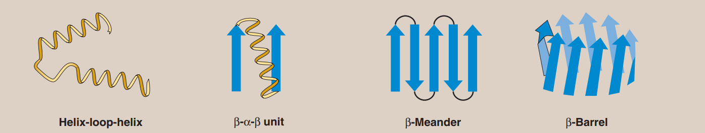
Supersecondary Structures: Motifs
Common combinations of secondary structure elements
Named on appearance
Often grouping are present in final protein structure
*common in transcription factors

Slide 5
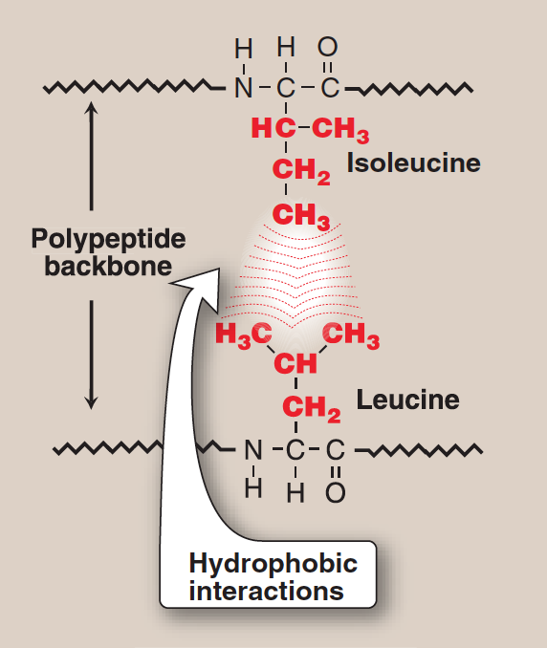
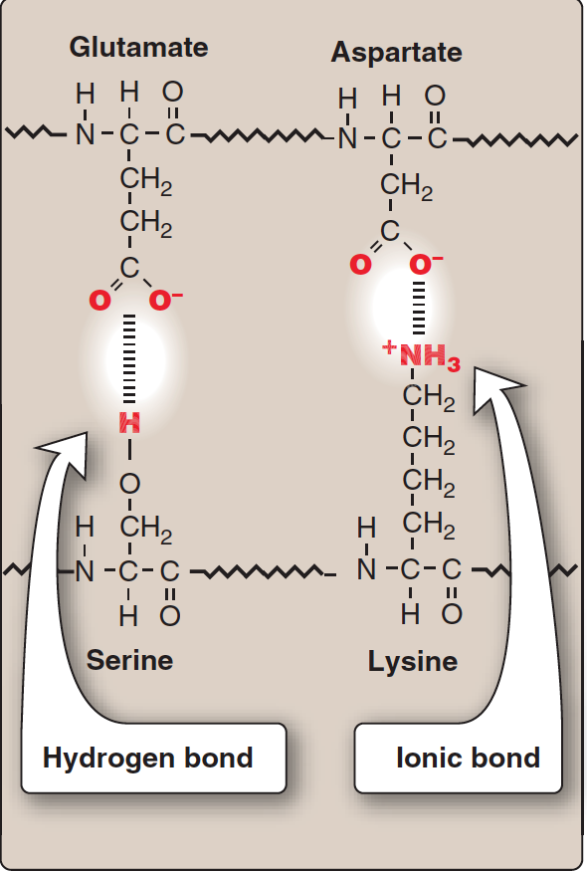
Tertiary Structure
Domain
Fundamental building block
Consists of motifs
Independently folds
Interactions of R-groups
S-S bonds (cysteine)
Hydrophobic interactions
Hydrogen bonds
Ionic interactions

Slide 6
Like dissolves like: why?
Predict where polar/nonpolar groups end up
Membrane
Polar groups on inside
Cytosol or other polar solvent
Polar groups on outside

Slide 7
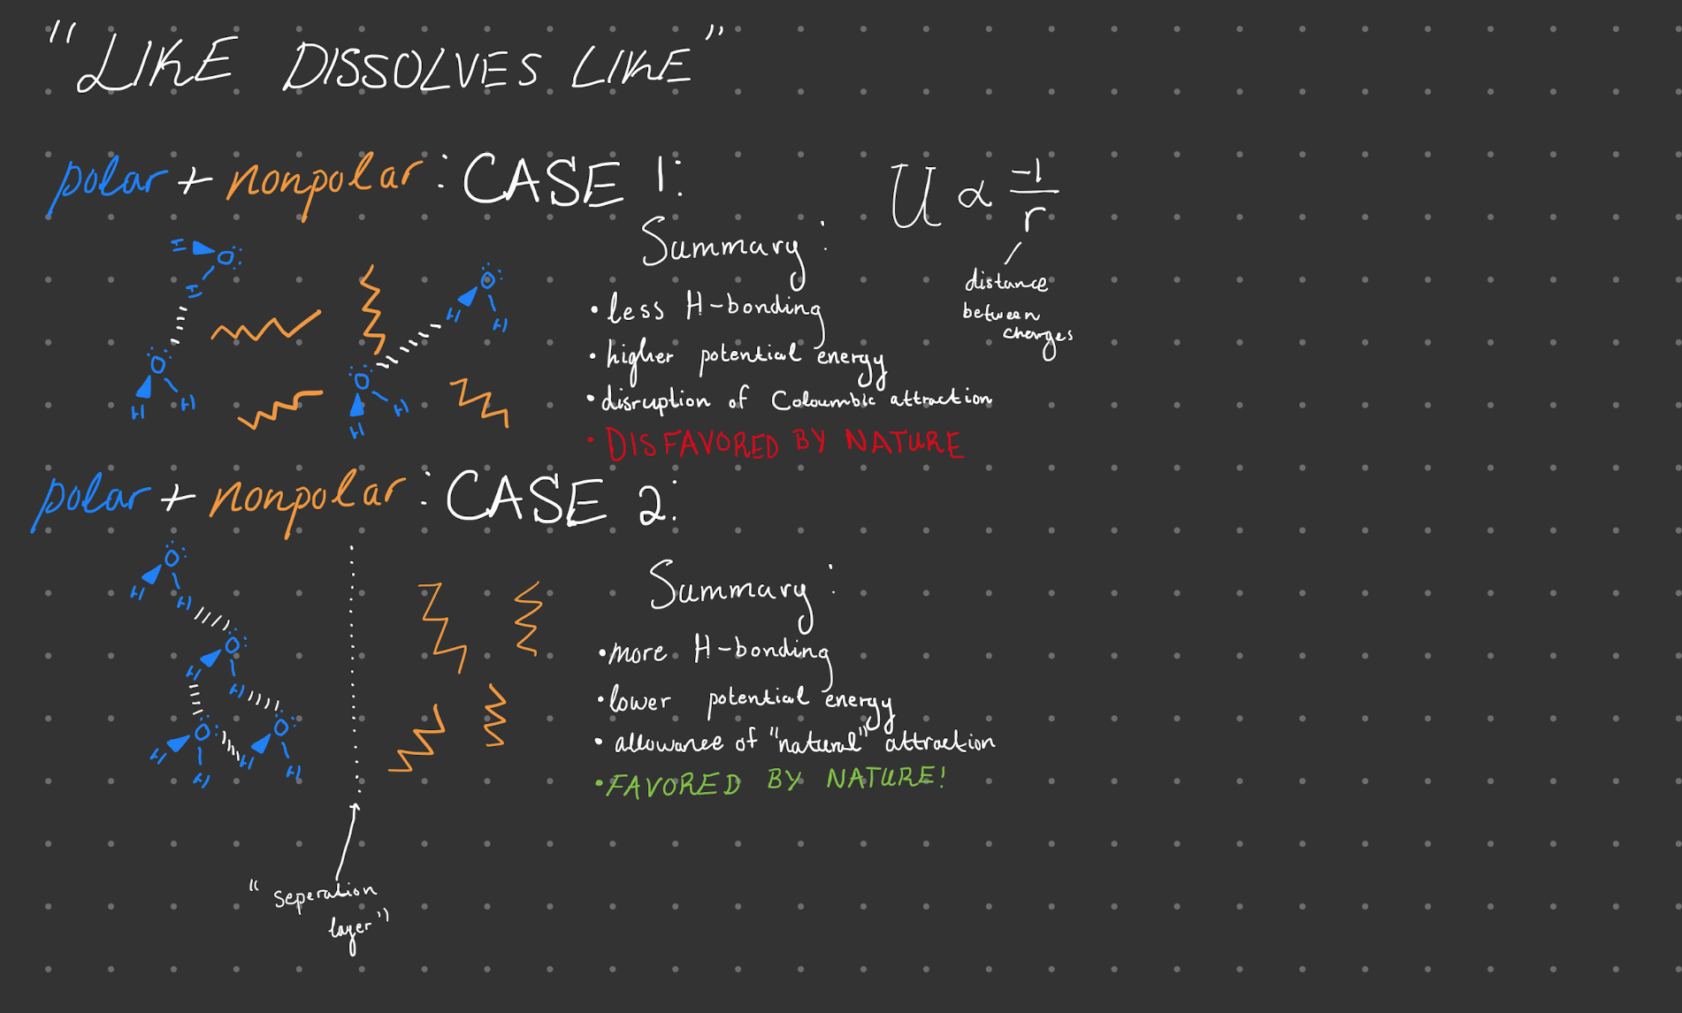

Slide 8
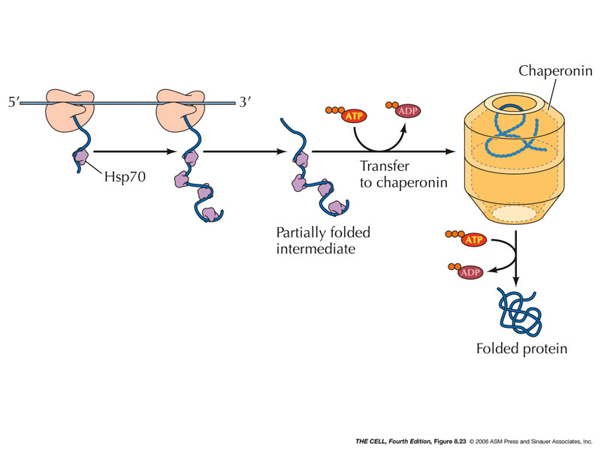
Chaperones (“Heat-Shock proteins”)
Protein don’t just fold once at end (can you explain benefit of not doing so using potential energy?)
Instead, guided by chaperones
Protect against unproductive interactions
Increase folding rate

Slide 9
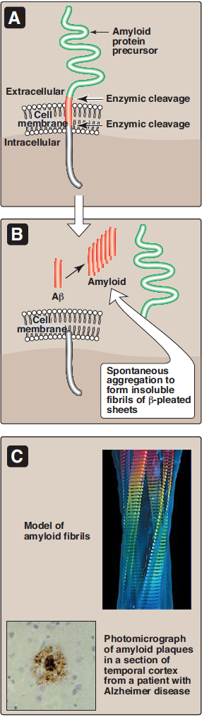

Slide 10
Creutzfeldt-Jakob (“mad cow”) Disease
Defective prion proteins IDENTICAL in primary structure
No post translational alteration difference
Normal → α-helix
Defective → β-sheet → resistant to breakdown

Slide 11
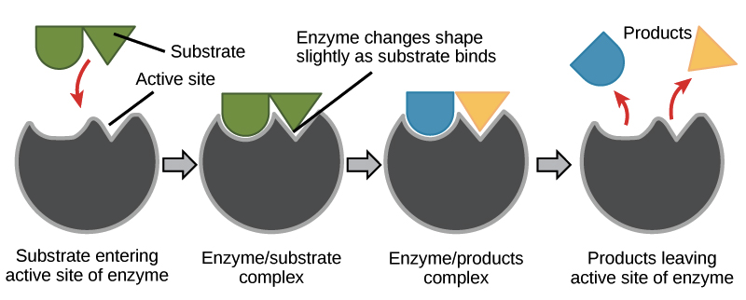
Induced Fit

Slide 12
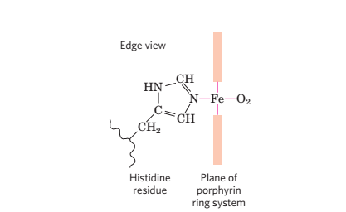
Reversible Binding of Oxygen
Oxygen binds to heme prosthetic group
Complex organic ring structure protoporphyrin
Two open coordination bonds in free heme molecules

Slide 13
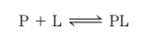
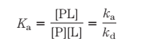
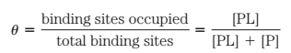
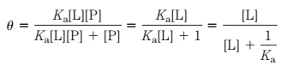
Quantification of Protein-Ligand Interactions
Reversible binding of protein (P) and ligand (L) described by equilibrium expression
K_{a} describes equilibrium between the complex and unbound components
K_{a} can be determined by plotting θ over the concentration of the ligand [L]

Slide 14
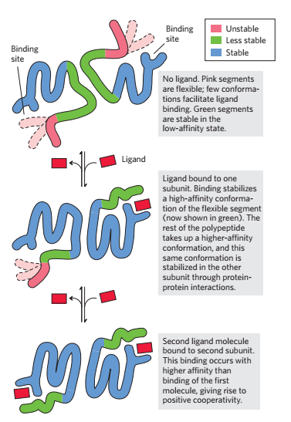
Allosteric Proteins
Binding of a ligand affects binding properties of another site.
Changes induced by modulators convert proteins between forms
Homotropic
Heterotropic
Cooperative binding to a multimeric protein
O₂ binding to hemoglobin

Slide 15
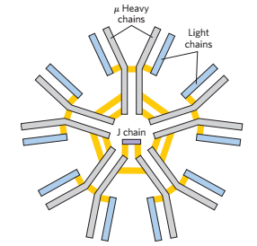
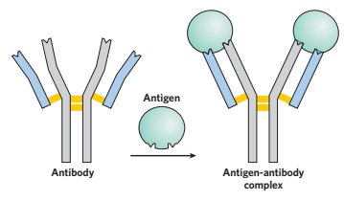
Antibody Structure
Antibodies bind antigens: pathogens which elicit an immune response
Constant domains have an immunoglobulin fold
Five types of immunoglobulins with unique type of heavy chain

Slide 16
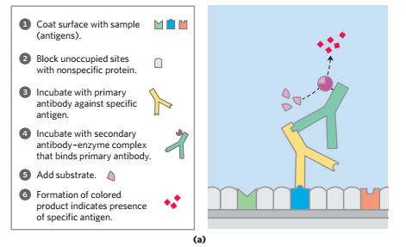
Analytical Techniques Using Antibodies
Polyclonal Antibodies
Produced by many different B lymphocytes
Monoclonal Antibodies
Produced by a population of identical clones
ELISA
Rapidly screen and quantify an antigen
Western blot
Proteins separated by gel electrophoresis and then treated with antibodies

Slide 17
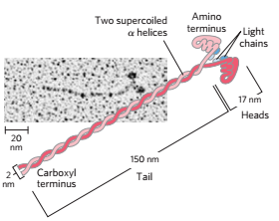
Myosin and Actin
Generate contractile force for muscles & arranged in sliding filaments
Myosin: 2 heavy chains and 4 light chains with α helices
Thick filaments
Actin
Thin filaments
Each monomer is bound to ADP

Slide 18
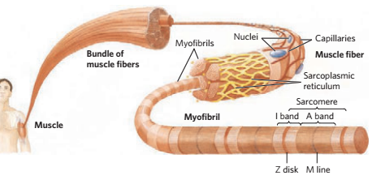
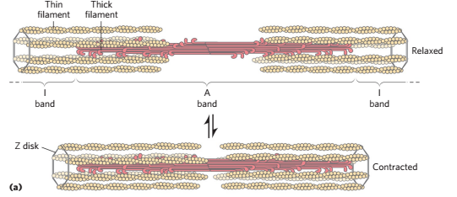
Muscle Contraction

Slide 19
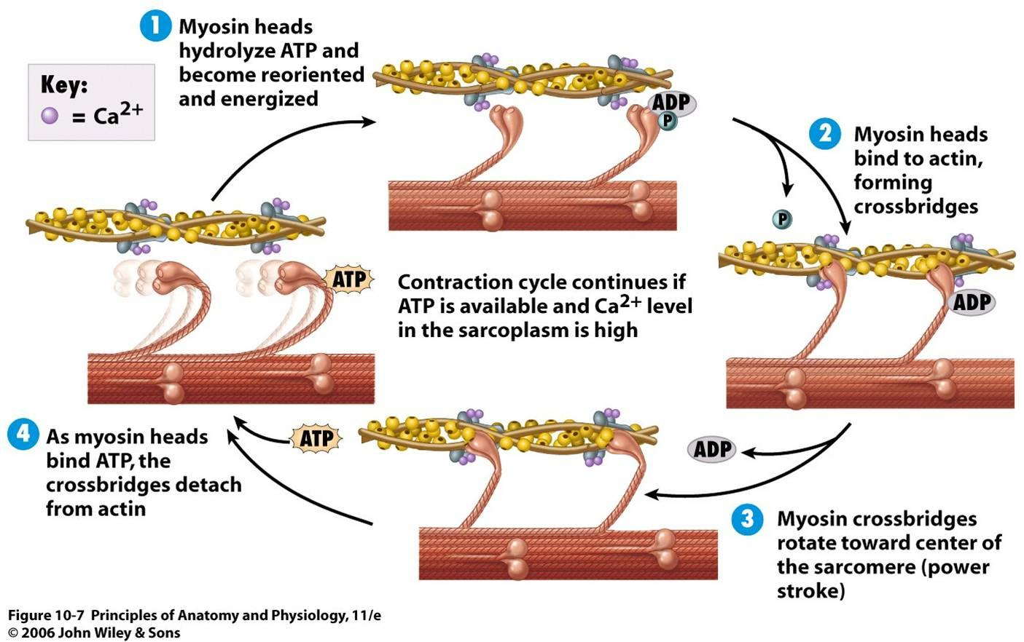
Myosin Movement
Protein changes to “high energy state” moving myosin head
Myosin cleft closes, binding myosin to the actin again
“Power stroke’ returns myosin to original resting state
ATP binds to myosin and bound actin is released

